Slide 1
Data Science Project Term 2-Tableau
Global Trade Analysis
By
Khetal Sarode
07/07/2019

Slide 2
Overview of the project
The objective of the project was to create innovative and interactive Tableau dashboards that focus on potential commodities, countries, year, trade amount and quantity.
The client wanted to launch a new business unit, focusing on global trade and logistics, majorly in the countries such as USA, Canada and Australia
They have collected import and export data of 12 major commodities including the commodity name, year(1988 to 2017), Trade, amount in USD quantity.
The dataset provided by the client contained 59090 observations of 10 variables
The Dataset contained missing values and was cleaned using the R programming language.

Slide 3
Data Description
Variable | Description
Country | There are three Countries-Australia, Canada, and the USA
Year | The Year Ranged from 1988 to 2016
Commodity Code | The commodity code was unique for each commodity. Example: 10420 for Goats, Live
Commodity | The commodity variable contained various trade commodities that belonged to each of the 12 categories.
Flow | This indicates flow of trade. They are Export, Import, Re-Import, and Re-Export.
Dollars | The trade value in US Dollars
Weight | The total weight of the traded commodity in Kgs
Quantity Name | Quantity name of the traded commodity
Quantity | The total quantity of the traded commodity
Category | There were 12 categories in the data.

Slide 4
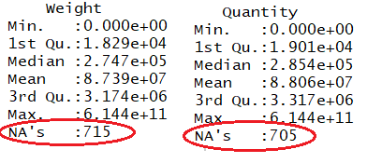
Data Preparation
The data was cleaned using the R programming language. The variable names were edited for better reading.
Upon exploring the dataset, it was found that the weight and the quantity variable contained missing values.

Slide 5
Data Preparation - continued
We Eliminate all Missing Values
Per business perspective, such losses cannot be ignored. Weight and Quantity are important variables that determine the trade value. Hence, the reason for such missing info has to be investigated.

Slide 6
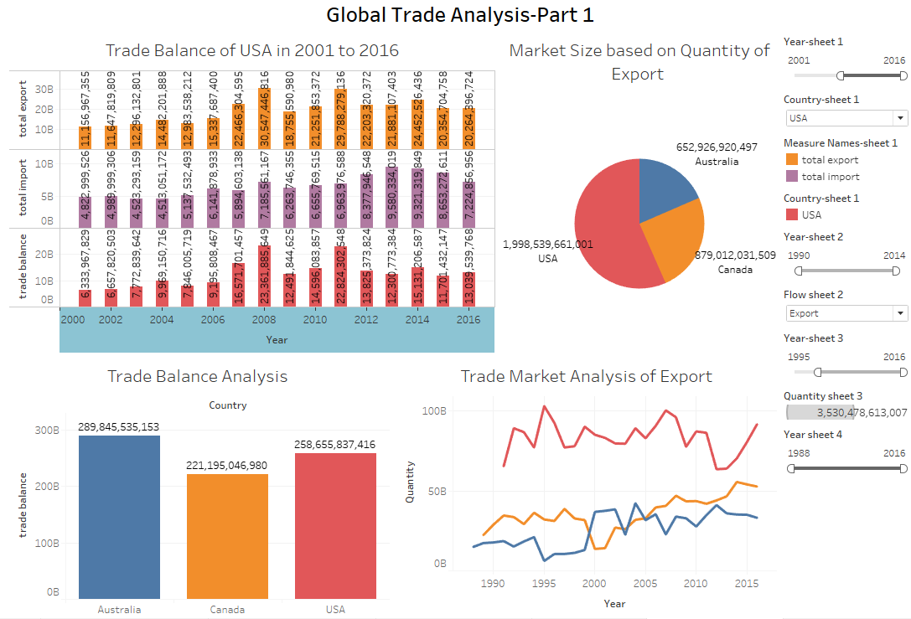
GLOBAL TRADE ANALYSIS-1

Slide 7
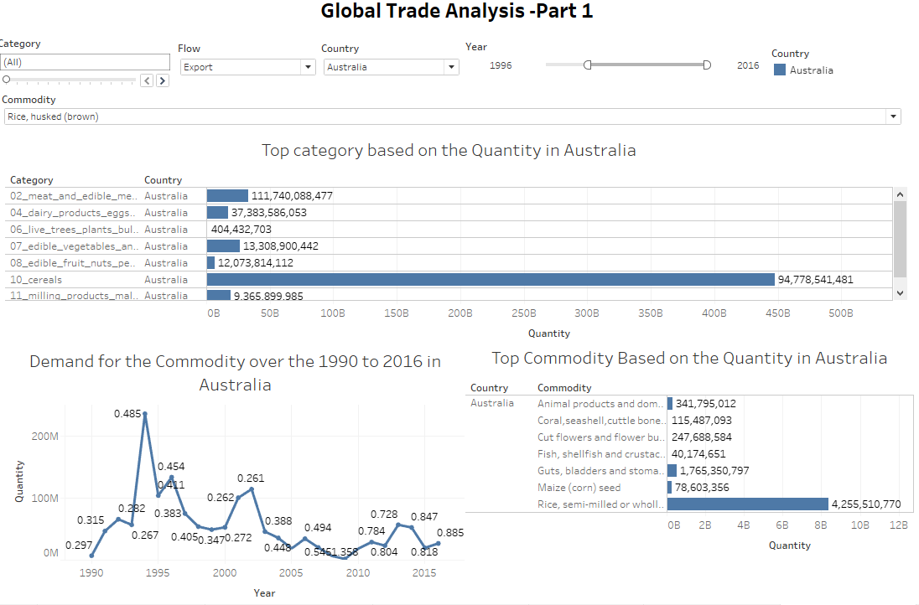
GLOBAL TRADE ANALYSIS-2

Slide 8
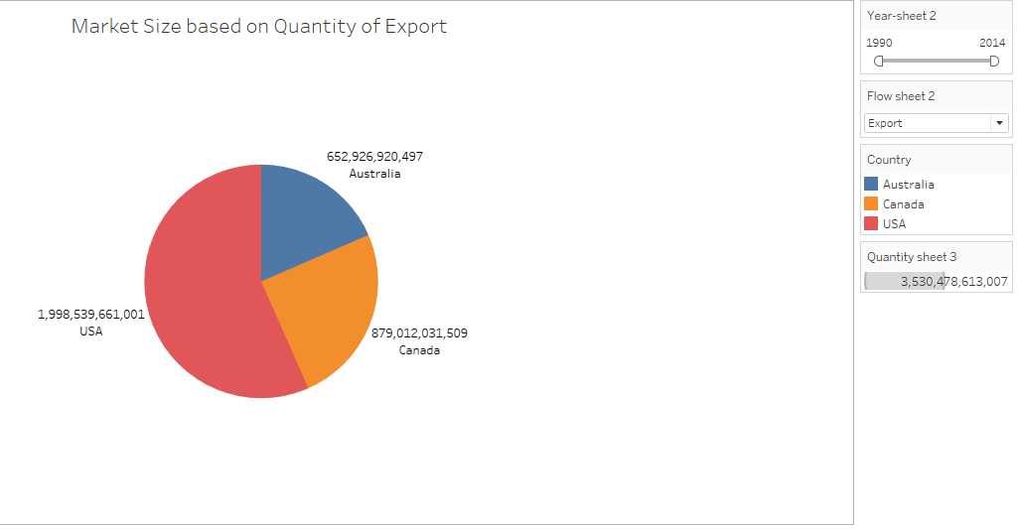
Market size based on the quantity
Action: Select the Flow of trade and set the range for Year to observe the insights described below.
Insight:
1) From 1988 to 2016, the USA has been the largest exporter, importer, and re-exporter of commodities. Whereas Canada has been the largest re-importer of commodities.
2) The USA has never re-imported commodities throughout these years.

Slide 9
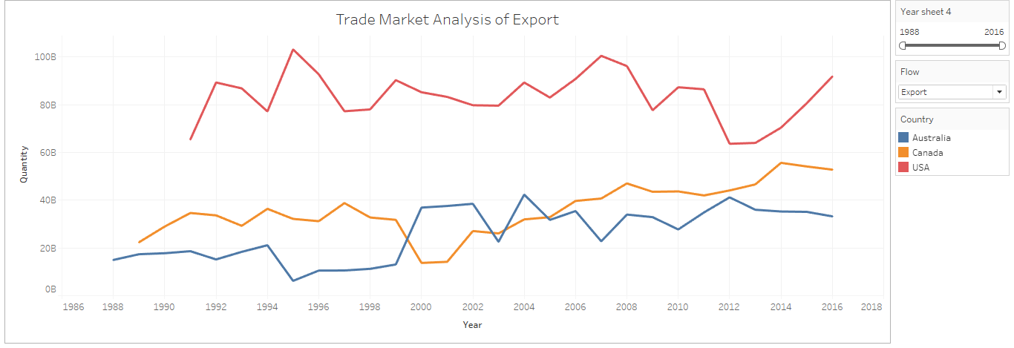
Trade market analysis
Action:- Select the flow of trade and the range of year to observe the insights given below.
Insights:-
1) Australia hasn't re-exported commodities since the year 1999.
2)Canada started the re-exported commodities from the year 2000.
3)Throughout the year Canada has the largest re-export commodities.
4)The USA has never re-imported commodities.
5) Along the year 1988 to 2017 USA has been dominant in export ,import and re-export of commodities.
6) Canada also dominates the re-import trade business.

Slide 10
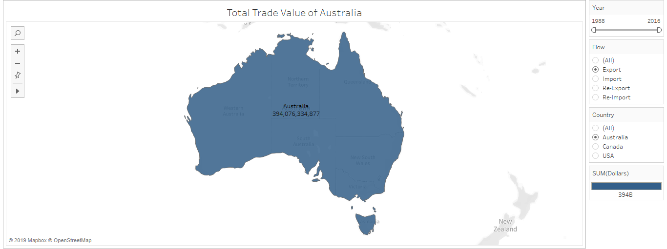
Total trade value
Action:
Select Country and Flow of trade from the filter tab. Set the range of Year as desired.
Insights:
1) The map displays the selected country and its total trade value based on the selected trade flow - export, import, re-export, or re-import.

Slide 11
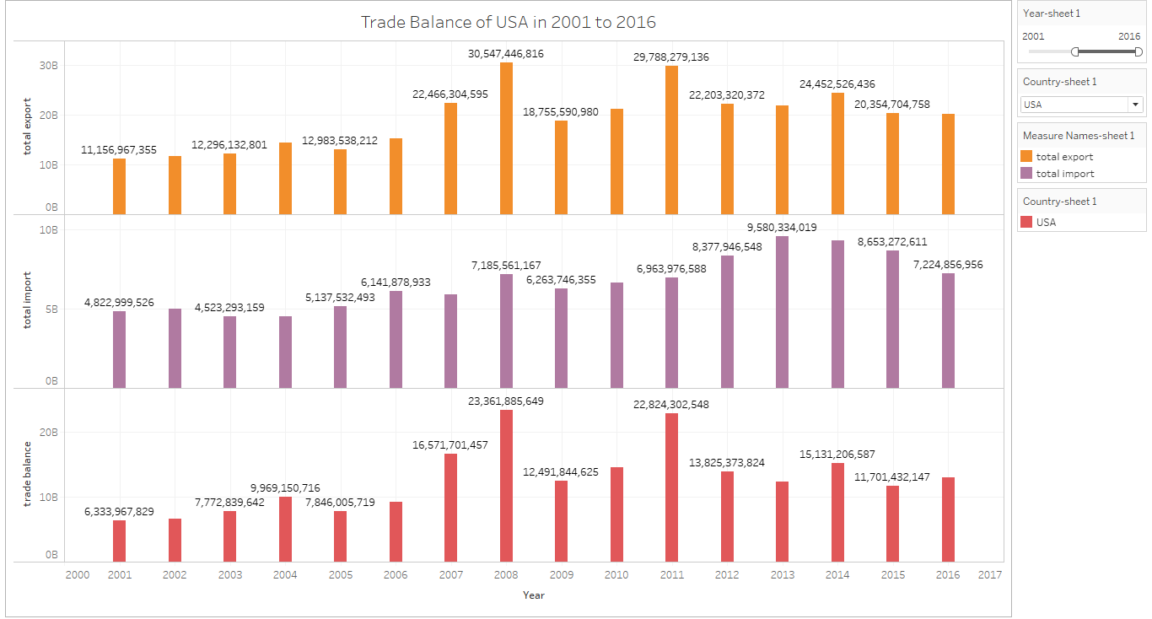
Trade Balance

Slide 12
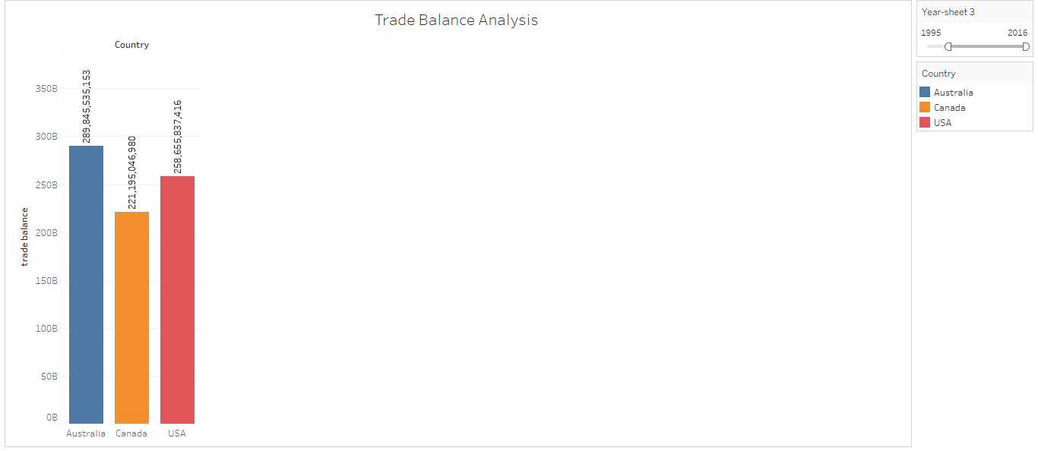
Trade Balanced Analysis
Action:- Select the Country and adjust the range of Year to observe the overall Trade Balance for those years.
Insight:-
1) The Ranking is in this order - Australia > USA > Canada for the years 1988-2017. While, for the years 2012 - 2017 the ranking is as follows - Australia > Canada > USA.

Slide 13
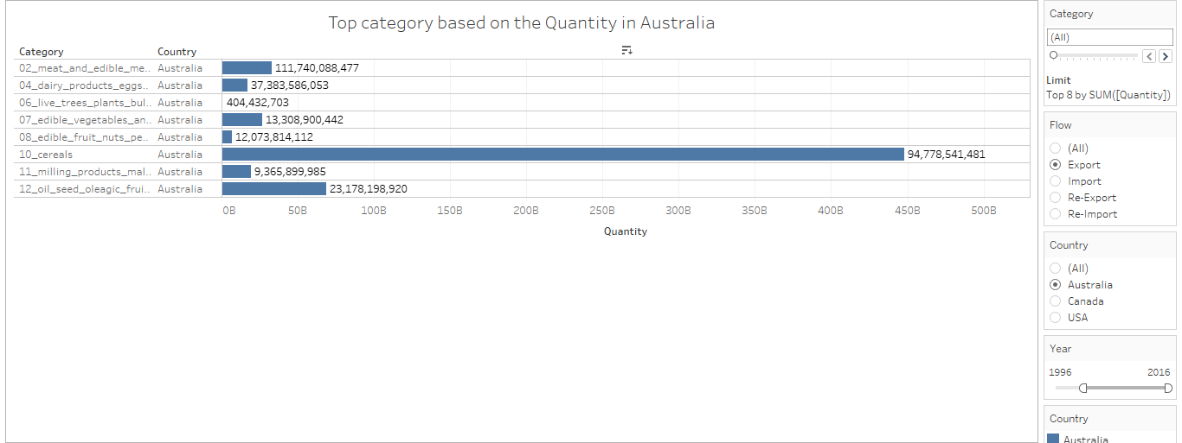
Top category based on the quantity
Action:- Select the Country and the Flow of trade from the filter tabs. Adjust the Year range as desired.
create one parameter based on the category and adjust the range as given below.
Insights:
1) Per the country and the flow of trade, we can observe the ranking of categories based on demand i.e. Quantity. Example: When we select Australia and Export from the filter tabs, we can observe the top categories.

Slide 14
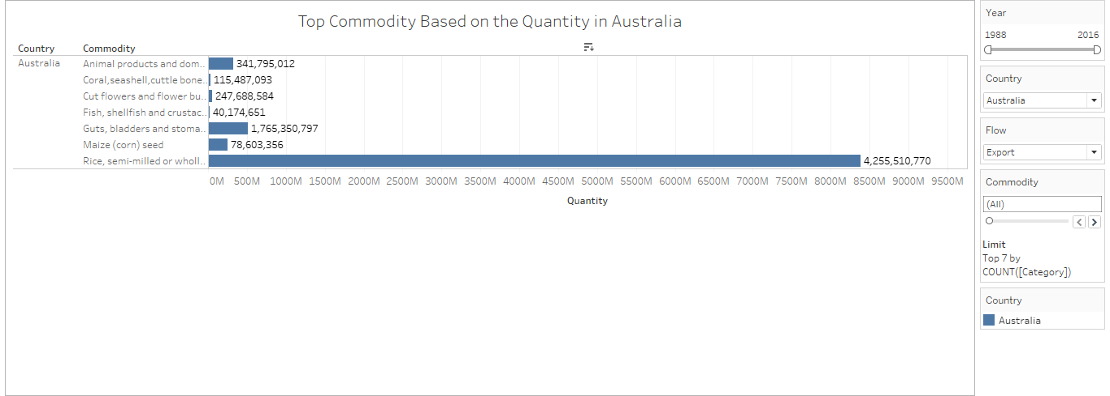
Top commodities based on the quantity
Action: Select the Country and the Flow of trade from the filter tabs. Adjust the Year range as desired.
create one commodity parameter for that we will show top commodities and adjust the range given below according to the flow of trade.
Observation: Each Category has a list of commodities. The chart shows the top commodities based on its demand i.e Quantity for the selected Flow of trade.
Insights:
1) Selecting the country and a flow of trade for the range of years, will show the top commodities based on the traded Quantity. Example: Selecting USA and Export from their filter tabs, and setting the year from 1988 to 2017, will show that "Rice semi-milled or wholly milled" as the largest exported commodity. The total trade value for this commodity during those years is labeled on the chart.

Slide 15
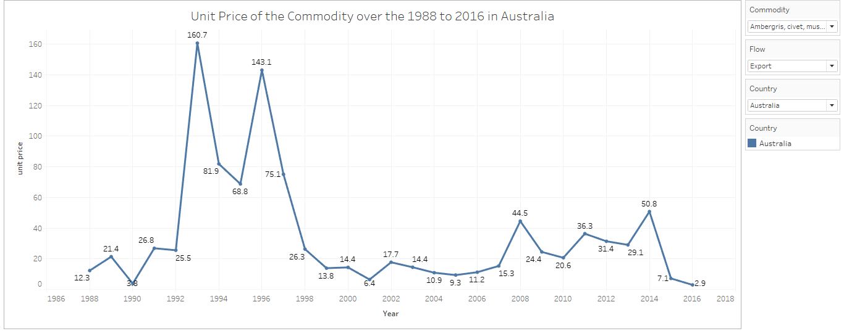
Unit price of the commodity over the year
Action: Select a country, a flow of trade , and a commodity from their respective filter tabs and observe the commodity's unit price for that country and flow of trade during a period.
Observation: The Unit price equals Trade Value / Quantity. The chart shows the unit prices for the commodity during the set period of years. The Unit price varies for each country and the flow of trade.
Insight:
1) Information on Unit prices can be seen for the selected country, flow of trade and commodity.
For Example: If we are interested in knowing the unit price for a top export commodity, we must select the commodity from the commodity filter. The line chart is color coded based on Country.
2) We can use forecasting techniques to find out future unit prices of the commodity.

Slide 16
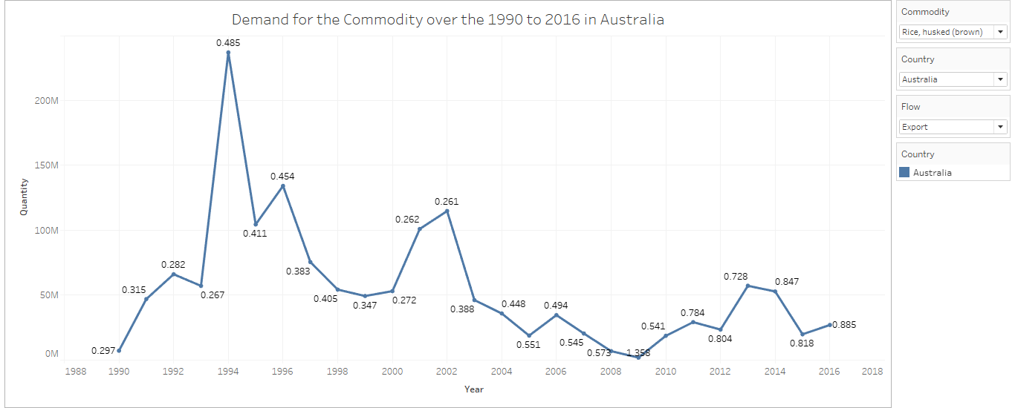
Demand for the commodity over the year
The trend of sum of Quantity for Year. Color shows details about Country Or Area. The marks are labeled by unit price. The data is filtered on Flow and Commodity. The view is filtered on Country Or Area and Year.
Action: Select a country, a flow of trade , and a commodity from their respective filter tabs and observe the commodity's demand for that country and flow of trade during a period.
Insight:
1) The fluctuation in the line chart indicates the quantity of a commodity exported, imported, re-exported, or re-imported for a country during a period.
2) Information on Unit prices can be seen for the selected country, flow of trade and commodity.
For Example: If we are interested in knowing the unit price for a top export commodity, we must select the commodity from the commodity filter. The line chart is color coded based on Country.

Slide 17
Conclusion
By analyzing the dataset and drawing the multiple graphs we arrive at a conclusion which is states that:
Australia is the country where the company should from the most because is the country have a highest trade amount
Wheat,Bovine cuts, Colza seeds, Durum wheat are some of the items where is the company should be most focusing.
The importance of collaboration to improve the quality of policy analysis world-wide is most clearly seen in the development of the GTAP Data Base.

Slide 18
Reference
How to calculate Trade Balance(https://bizfluent.com/how-6516337-calculate-trade-balance.html)
Balance of Trade(https://corporatefinanceinstitute.com/resources/knowledge/economics/balance-of-trade-bot/)

